Slide 1

Corso di Software Engineering
a.a. 2020/2021
Ingegneria Informatica Magistrale I anno
Project Work
Team 7 :
Santella Alessandro (mat. 0622701526)
Tedesco Christian (mat. 0622701528)
Salsano Carmine (mat. 0622701527)
Zuozo Arianna (mat. 0622701482)

Slide 2
01
02
04
Index
03
Front-end development
Back-end development
Testing
Working software

Slide 3

1. Back-end development
Building the database, the code that lets it communicate with the front-end and the methods to elaborate the data

Slide 4




Technologies involved in the development of the back-end
JAVA
JSP
POSTGRESQL
APACHE
TOMCAT
Java has been utilized to create a connection with the database, manage and elaborate data received from the web pages and the tables of the DB.
JSP is the technology situated between the web pages and Java, to make possible the sharing of data between the DB and the front-end.
PostgreSQL is the DBMS used to create, host and manage the database directly. It also permits to write SQL queries with the environment’s tools.
Apache Tomcat is the server used to host the web application written in Java. It implements the JSP specifics and makes possible the management of the app in a very simple way.

Slide 5
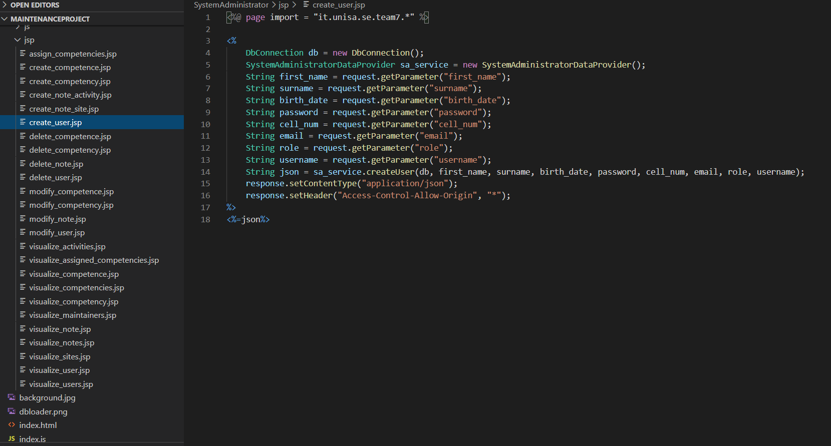
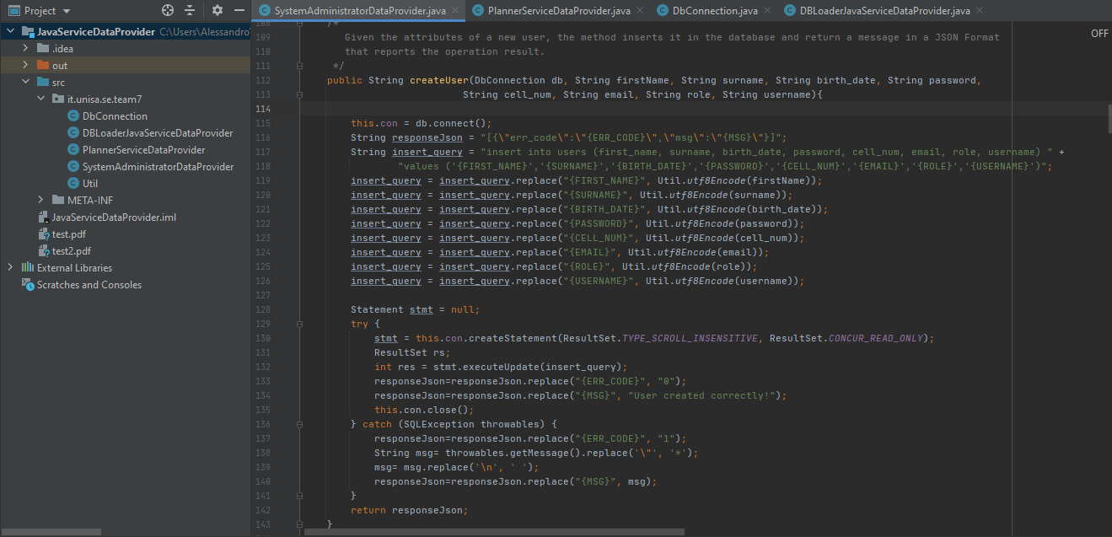
An example of the use of Java and JSP
JAVA
JSP
In Java we have written a class for each user that operates in the system, containing the methods to implement every needed service. Each method connects with the database and executes a query with the values selected by the user in the web interface or with the data retrieved from the database. Here is an example for the creation of a user in the System Administrator part.
We have also produced many JSP files, even more than one for some web pages, to call the methods created in Java and pass the information retrieved with them to the interface, in order to show them or dynamically change the pages looking at the values. Here is an example for the creation of a user in the System Administrator part.

Slide 6
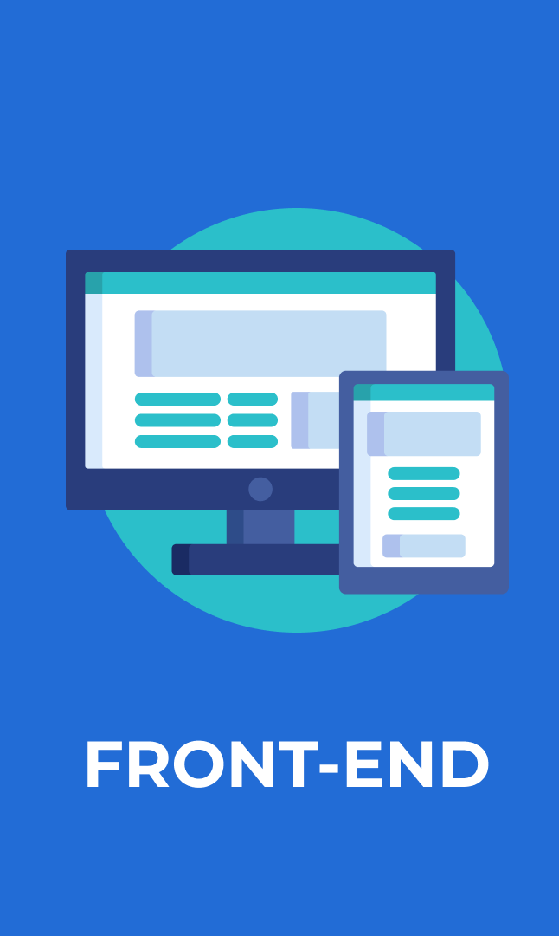
2. Front-end development
Building the web pages, which are the interface for every user of the system, with their style and dynamic behavior

Slide 7
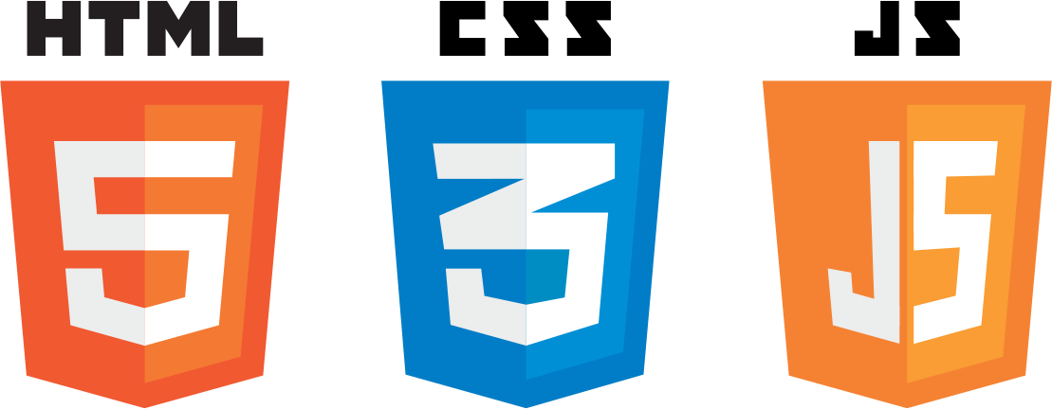


Technologies involved in the development of the front-end
HTML
JAVASCRIPT
BOOTSTRAP
The famous markup language has been used to build the web pages “statically”.
We used Javascript to give a dynamic behavior to each page of the application, like changing the values displayed etc.
We used Bootstrap to manage the web pages’ style in a more efficient way, using the classes and the grid system.
CSS
JQUERY
CSS has been used to decorate the web pages, so to change dimensions, colors and other features of each element.
This Javascript library has been used to facilitate the dynamic behavior of the application and to manipulate various objects, such as modals.

Slide 8
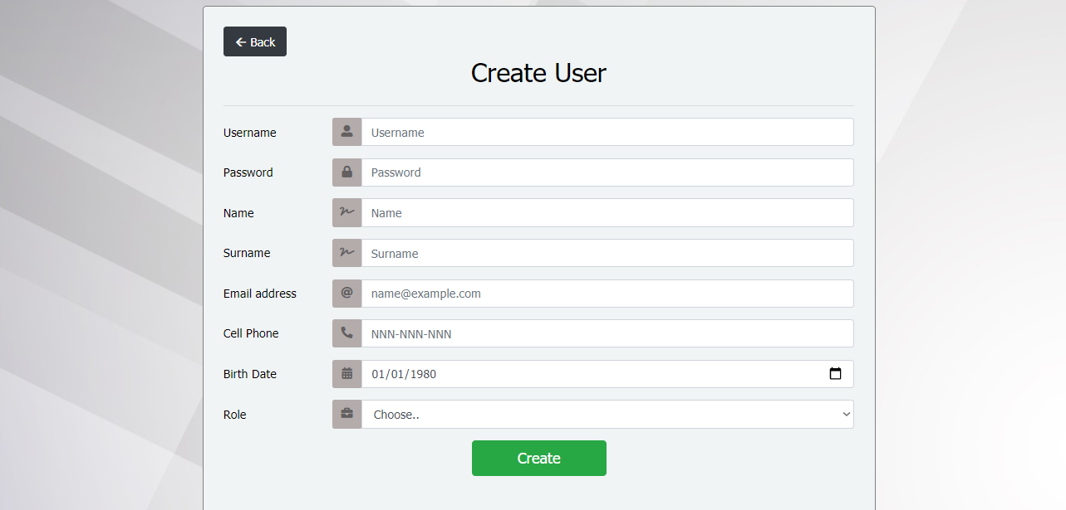
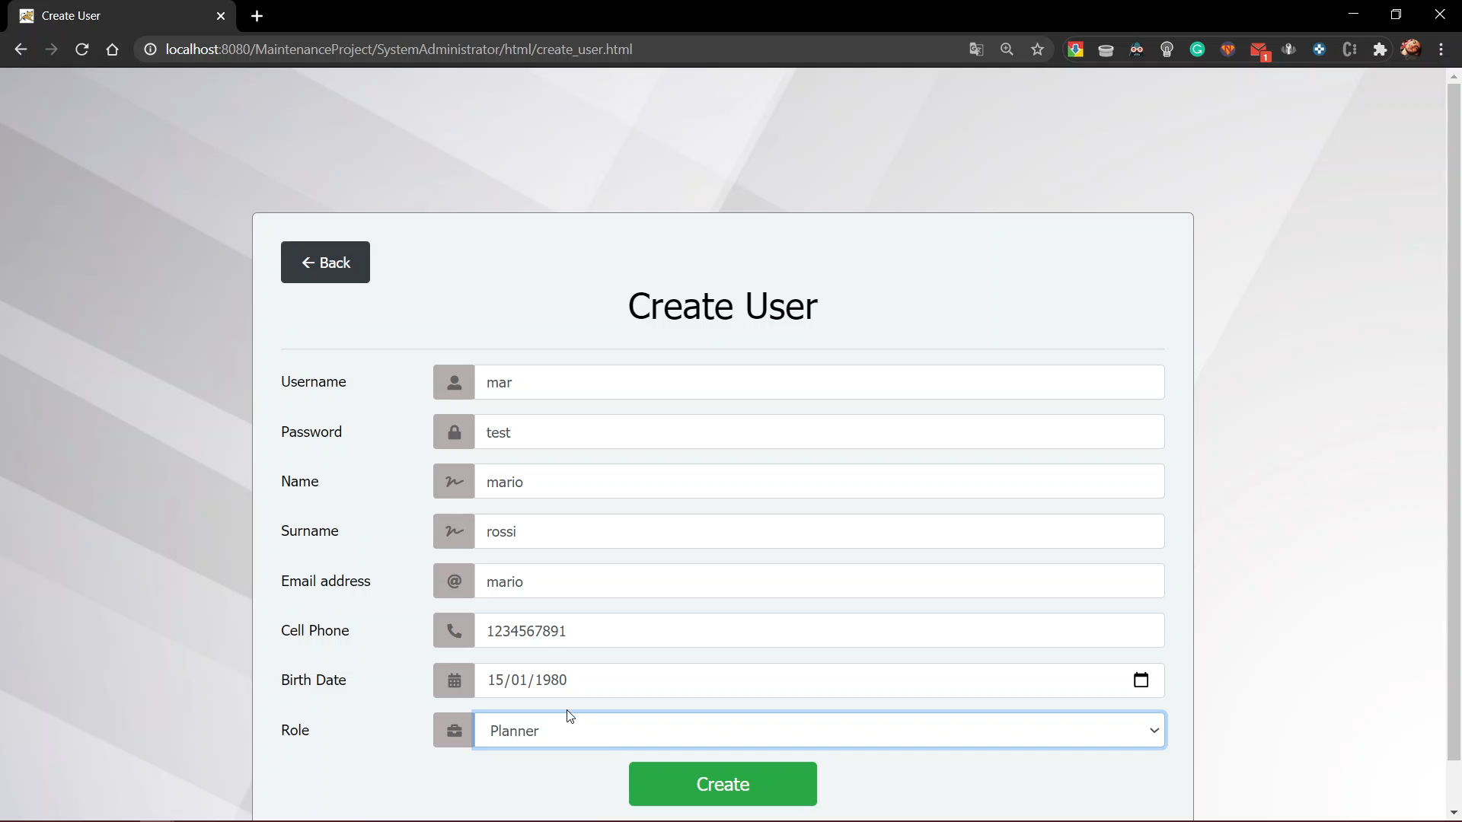
An example of the use of HTML, CSS and Bootstrap
An example of the use of jQuery and Javascript

Slide 9

3. Testing
Detecting and correcting errors in the software product, solicitating the class methods to assure that data enters and exits correctly.

Slide 10

Technologies involved in the development of the testing
JUNIT
JUnit is the framework that we have used for the unit testing of the Java code. Each class of the software is associated to a testing class that contains a test method for each method of the original class. The framework makes possible the design of the testing methods and the execution of them automatically.

Slide 11
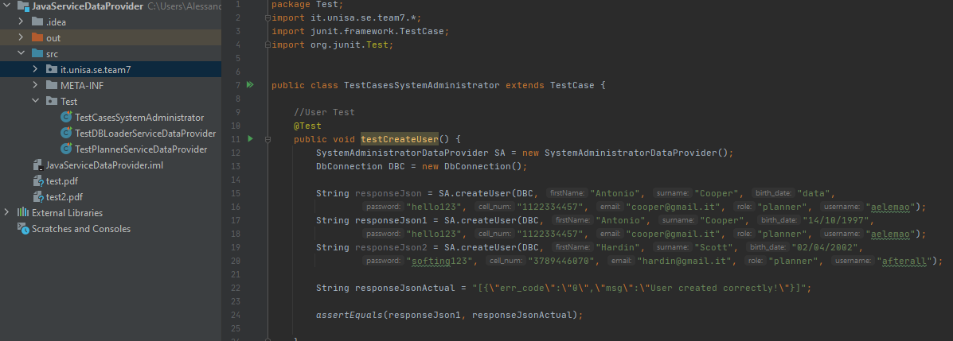
An example of the use of JUnit
The test methods must verify the truthness of many different conditions, using the assertions. The testing used for our software has each method containing conditions that lead to errors and others that lead to a successful result. In this way, we check how the system behaves, so what’s the output given, with common wrong and correct inputs. Here is an example of testing for the method used to create a new user in the system, with different inputs that lead to failure or success.

Slide 12

4.Working software
Explanation and demostration of some parts that compone the software, with videos and snaps.

Slide 13
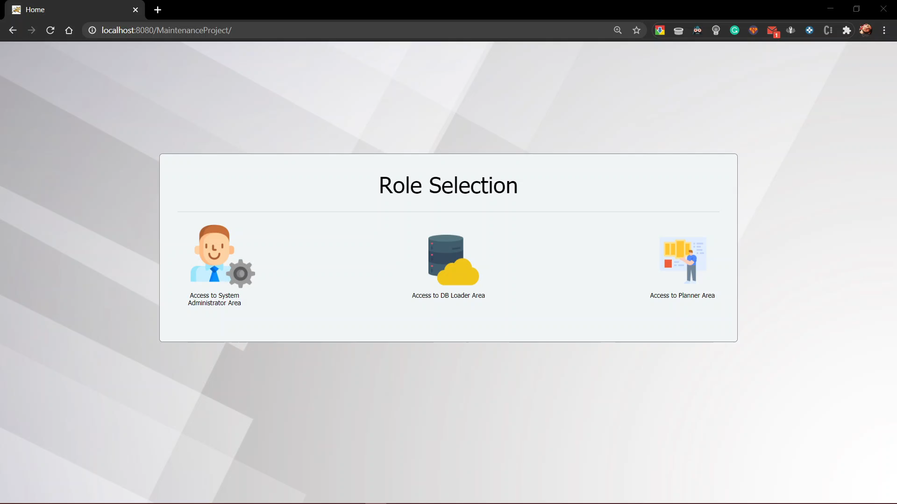
Video – User creation

Slide 14
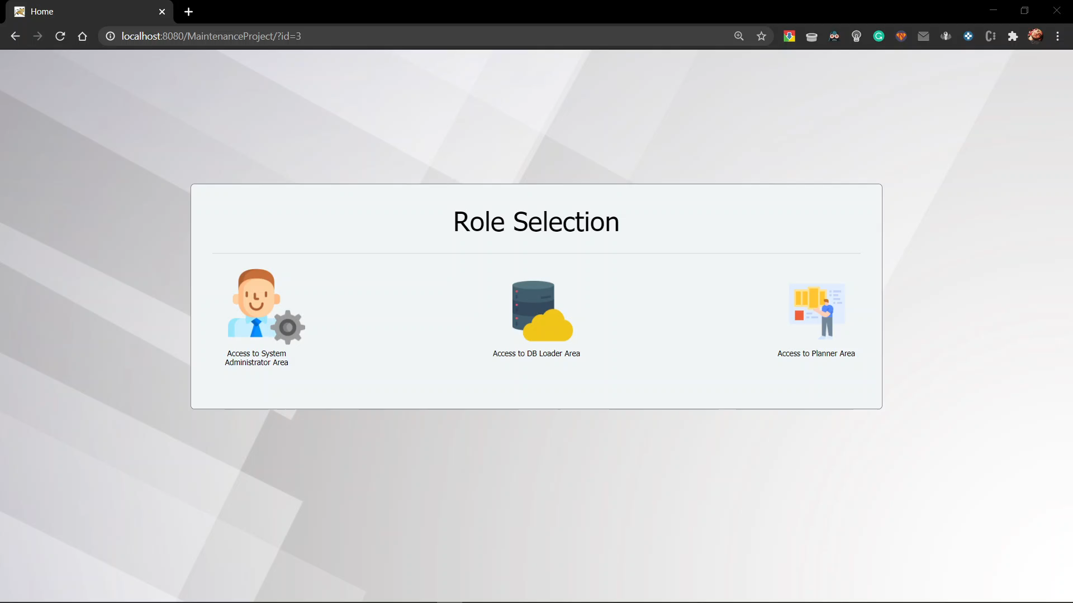
Video – Maintenance activity creation

Slide 15

Video – Maintenance activity assignemnt

Slide 16
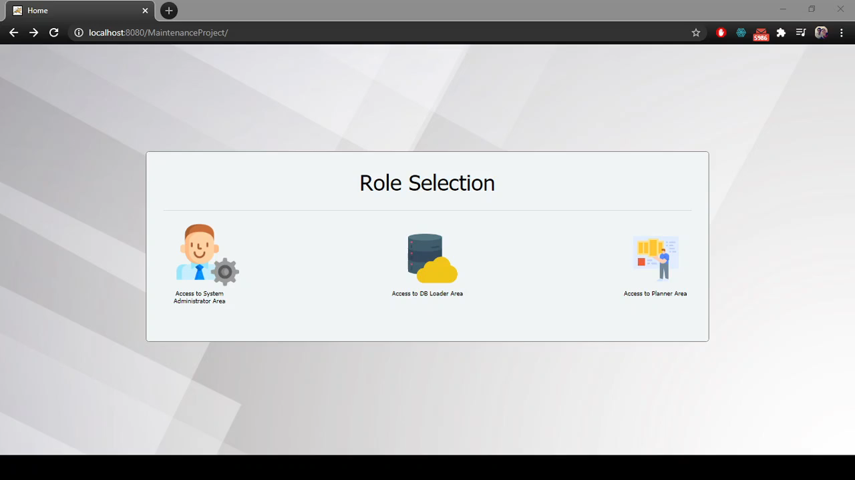
Video – EWO assignment

Slide 17

Thank you for the attention!

